Slide 1


HTTP

Slide 2
WHAT IS HTTP?
HTTP is a protocol for fetching resources such as HTML documents. It is the foundation of any data exchange on the Web and it is a client-server protocol.
Clients and servers communicate by exchanging individual messages. The messages sent by the client, usually a Web browser, are called requests and the messages sent by the server as an answer are called responses.

Slide 3
COMPONENTS OF HTTP
HTTP is a client-server protocol: requests are sent by one entity, the user-agent (or a proxy on behalf of it). Most of the time the user-agent is a Web browser, but it can be anything, for example, a robot that crawls the Web to populate and maintain a search engine index.
Each individual request is sent to a server, which handles it and provides an answer called the response. Between the client and the server there are numerous entities, collectively called proxies, which perform different operations and act as gateways or caches, for example.

Slide 4

Client & Server

Slide 5
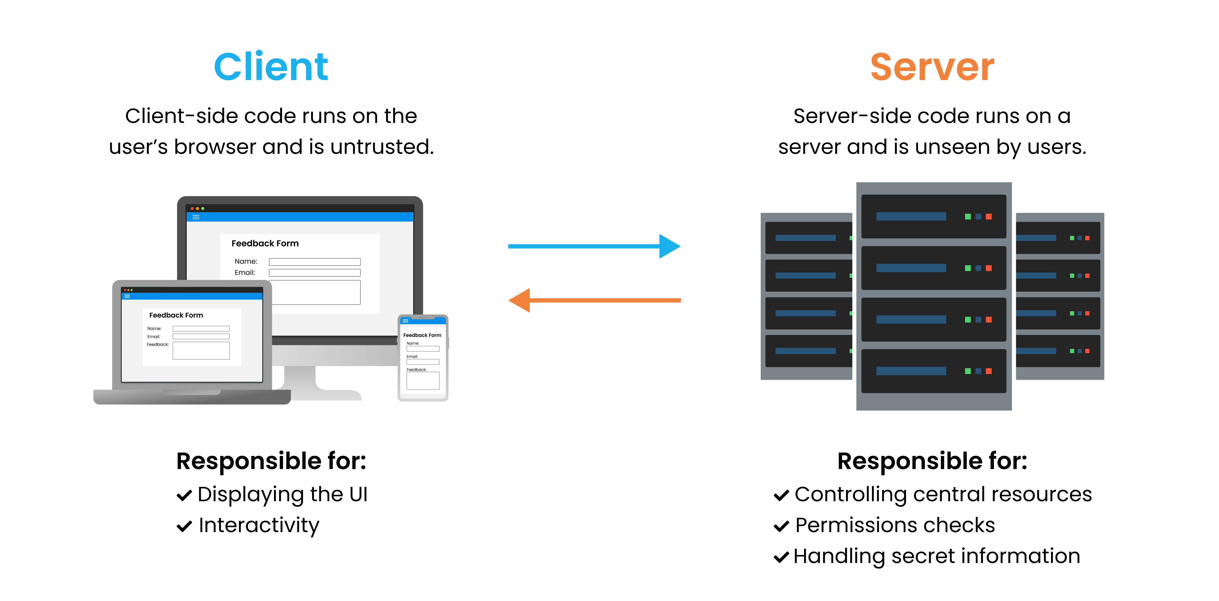
Client & Server

Slide 6
Client: the user-agent
The user-agent is any tool that acts on behalf of the user. This role is primarily performed by the Web browser, but it may also be performed by programs used by engineers and Web developers to debug their applications.
To display a Web page, the browser sends an original request to fetch the HTML document that represents the page.

Slide 7
The web server
On the opposite side of the communication channel is the server, which serves the document as requested by the client. A server appears as only a single machine virtually; but it may actually be a collection of servers sharing the load (load balancing), or a complex piece of software interrogating other computers (like cache, a DB server, or e-commerce servers), totally or partially generating the document on demand.

Slide 8
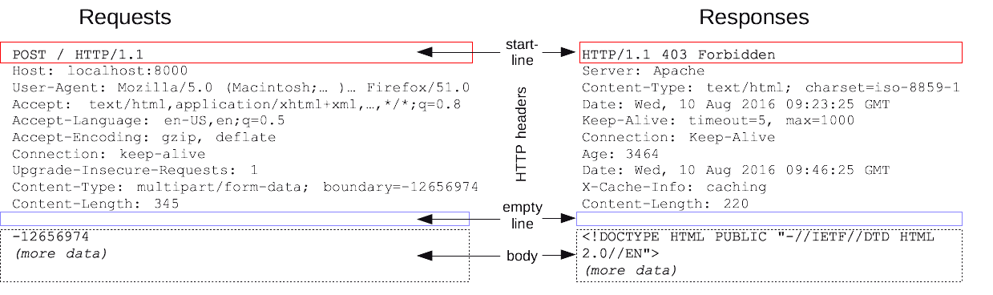
HTTP Messages
HTTP messages, as defined in HTTP/1.1 and earlier, are human-readable. There are two types of HTTP messages, requests and responses, each with its own format.

Slide 9
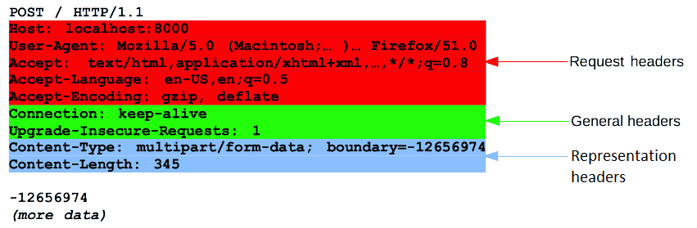
HTTP Messages

Slide 10
Requests consist of the following elements
An HTTP method, usually a verb like GET, POST, or a noun like OPTIONS or HEAD that defines the operation the client wants to perform. Typically, a client wants to fetch a resource (using GET) or post the value of an HTML form (using POST), though more operations may be needed in other cases.
The path of the resource to fetch; the URL of the resource stripped from elements that are obvious from the context, for example without the protocol (http://), the domain (here, developer.mozilla.org), or the TCP port (here, 80)
The version of the HTTP protocol.
Optional headers that convey additional information for the servers.
A body, for some methods like POST, similar to those in responses, which contain the resource sent.

Slide 11
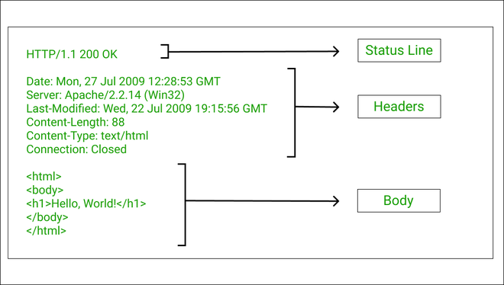
HTTP Responses

Slide 12
Responses consist of the following elements
The version of the HTTP protocol they follow.
A status code, indicating if the request was successful or not, and why.
A status message, a non-authoritative short description of the status code.
HTTP headers, like those for requests.
Optionally, a body containing the fetched resource.

Slide 13
HTTP Status Codes
HTTP response status codes indicate whether a specific HTTP request has been successfully completed.
Responses are grouped in five classes:
Informational responses ( 100 – 199 )
Successful responses ( 200 – 299 )
Redirection messages ( 300 – 399 )
Client error responses ( 400 – 499 )
Server error responses ( 500 – 599 )

Slide 14
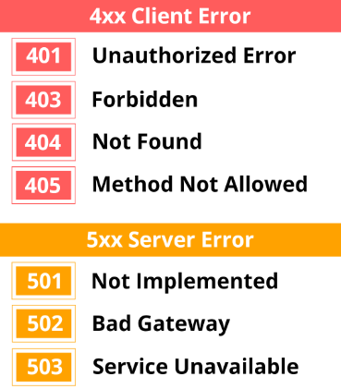
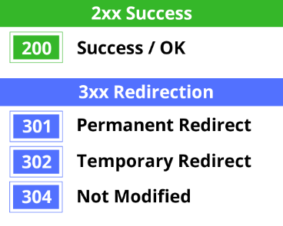
HTTP Status Codes

Slide 15
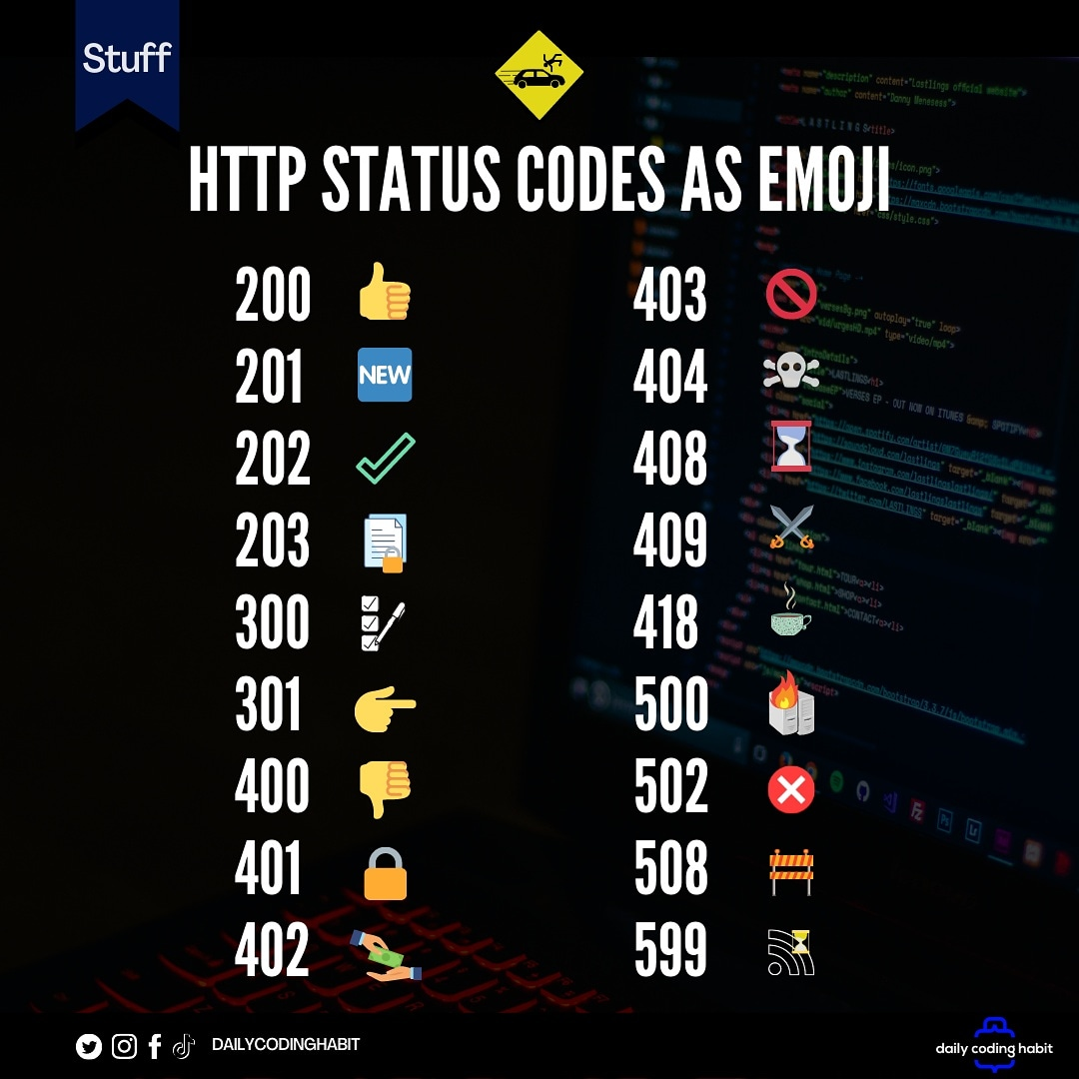
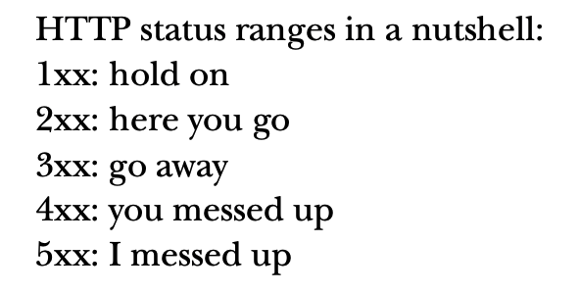

Slide 16


HTTP MODULE IN NODE
To make HTTP requests in Node.js, there is a built-in module HTTP in Node.js to transfer data over the HTTP. To use the HTTP server in node, we need to require the HTTP module. The HTTP module creates an HTTP server that listens to server ports and gives a response back to the client.

Slide 17
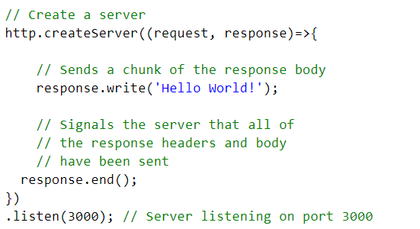
We can create a HTTP server with the help of http.createServer() method.

Slide 18
QUESTIONS?
You can find us at:
mail
main

